Slide 1

CHATBOT Restaurant Recommendation System Team 13
Arun Soundararaj
Bharath Sivaraman
Louis Arokiaraj Gilbert
Vrushali Sudhir Peshave

Slide 2
What ?
A dialogue system - Chatbot.
Recommends restaurants based on user preferences
Cuisine
Location
Price
Analysis of user reviews.

Slide 3
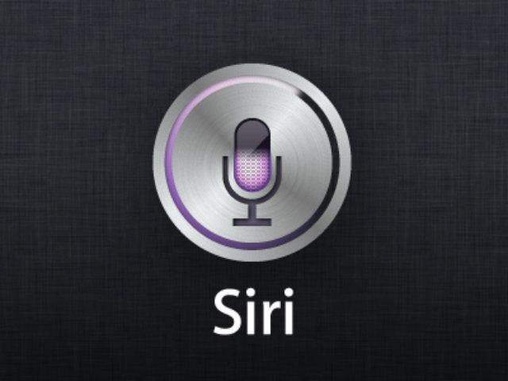


Why ?
Cognitive assistants are the evolving technology
Handling of multiple NLP sub tasks
Involves Human-computer interaction

Slide 4





How ?
Suggest Italian restaurants in Seattle?
O/P: Speech to text
[ Italian – Cuisine,
Seattle – Location ]
Speech Recognizer (Pocket Sphinx)
NLU (CRF)
Dialogue Manager
Ask for price. Confirm user preferences
Sentiment Analyzer
Top 3 restaurants

Slide 5
Evaluation
Speech Recognition – Word Error Rate
Natural Language Understanding – Precision and Recall
Sentimental Analysis of reviews – Precision and Recall
Overall System’s Evaluation – Survey

Slide 6
Future Enhancements
Text to speech
Learning from previous chat sessions
More user preferences
More refined user interactions
Performance Optimization

Slide 7
A Quick Demo !
Demo Link: https://www.youtube.com/watch?v=DWipYowZmaU

Slide 8
References
http://ieeexplore.ieee.org/abstract/document/7041732/
http://cmusphinx.sourceforge.net/wiki/
http://www.chokkan.org/software/crfsuite/manual.html
https://www.yelp.com/developers/documentation/v3
https://github.com/nltk/nltk/wiki
http://cs229.stanford.edu/proj2014/Yun%20Xu,%20Xinhui%20Wu,%20Qinxia%20Wang,%20Sentiment%20Analysis%20of%20Yelp's%20Ratings%20Based%20on%20Text%20Reviews.pdf

